Slide 1
Lions MD 202 Treasurers Seminar
Multiple District Treasurer
Roadshow Update
Hosted by: Steve Bennett
May 2016
May 2010

Slide 2
Issues to ponder…
Template for Charitable Trust Annual Filing
Trust Administrative Procedures
What Administration Funds actually should be used for
Circle of Membership rule and Tax Implications
What’s ahead for treasurer Support
Q & A Session

Slide 3
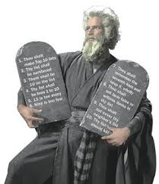
Template for Charitable
Trust Annual Reporting

Slide 4
Main Points
This template is based on a Tier 4 Reporting entity
Remember to make sure that your Trust is a T4 entity, the standard deed allows you to adopt this Tier.
If your annual expenses are in excess of $150,000 you are a Tier 3 entity and additional disclosures are required.
You can adopt a higher level of reporting without a change in Tier Status.
NB: Make sure your notes cover that you are reporting as a Tier 4 entity but have decided to disclose above the minimum requirements.

Slide 5
Template Access
through Charities Services
Go to
https://charities.govt.nz/new-reporting-standards/tier-4/standard-template-and-guidance-notes/
Scroll down the page to Excel template and download the appropriate version to your system application
Save this template to your computer, then enter;
Open Excel Spreadsheet
Click on [Header (START HERE)] Tab at the bottom of page
Full name of entity
Lions Club of ‘anywhere’ Charitable Trust (LC_CT)
For the year ended
31 ________ 20XX
Continued…

Slide 6
Entering template data….
Click [Content] tab
You will note that your club name and year end date has transferred to this page.
Enter your [Entity Information] (page numbers)
* Hint: you may wish to do this last when you know how many pages you need.
4) Click [Entity Info] tab
Entity’s Purpose or Mission
To assist the community of ‘anywhere’ with a range of services based on the humanitarian principles outlined in the International Lions Clubs Charter.

Slide 7
Entering template data….
Entity Structure
LC_ CT is run by an elected group of 4 Trustees. The Trust works in conjunction with the Lions club of ‘anywhere’ to identity assistance programmes for the community of ‘anywhere’.
The Trustees are all volunteers, with one Trustee retiring at each Annual General Meeting (that person is eligible to re-stand for appointment should they choose to do so).
The Trustees engage independent contractors as the need arises to assist with the delivery of community projects.

Slide 8
Entering template data….
Main sources of entities cash and resources.
LC_CT receives funding from community donations as well as grants and contractual income from other external agencies.
7) Main methods used by the entity to raise funds
LC_CT relies on community donations, as well as project delivery grants from other community trusts.
On occasion contractual income is received to deliver community projects.
Entity’s reliance on volunteers and donated goods and services.
LC_CT is a volunteer organisation, the volunteers assist with all Trust operations and are integral in the delivery of all community projects.

Slide 9
Entering template data….
Statement of Service Performance
Description of the entity’s outcomes.
The Lions Club of ‘anywhere’ CT has carried out the following main projects during the year.
Run a suicide awareness programme to assist with youth awareness and harm reduction.
Run a community fireworks show, the proceeds of which assist a wide range of community groups with development grants.
Run a charity golf tournament, the proceeds of which are used for the development of youth and sports initiatives.
Run a charity race day, the proceeds of which are used for targeted community development grants.
Run a magic show, the proceeds of which are targeted to youth development grants.

Slide 10
Entering template data….
Description and qualification of the entity’s outputs.
Suicide Awareness Programme Enquiries received 10
Targeted assistance provided 2
Fireworks Community grants provided 6
Charity golf Community grants provided 3
Charity Race Day Community grants provided 2
Charity Magic show Children attending show 700
Community grants provided 2
Total volunteer hour over all community projects 2,100
NB: Most of this information will be set out in M & A Reports, Just summarise it.

Slide 11
Commentary
Specific details for the previous year have not been kept as this is the first year of reporting under the new requirements.
All community events are widely publicised via our co-delivery partners of radio ‘anywhere’ and the ‘anywhere’ chronicle
Community projects activity is also reported to our National Lions NZ entity on a monthly basis.

Slide 12
Statement of Financial
Performance and
Statement of Financial Position
Use the accounts which you would normally file, the important factors are:
You need to include comparative information (last years figures)
Include a note saying that your entity is providing a higher level disclosure than required, (if indeed it is).
Include a note that the Trustees have adopted a Tier 4 basis of presentation.
If you have a Tier 3 entity higher disclosure is required, in addition a statement of cash flows is required.

Slide 13
Trust Administrative Procedures

Slide 14
Issues which have arisen
Make sure there is at least three meetings per year, one of which is an AGM.
Keep minutes of meeting – separate these from the club.
Rotate Trustee membership, new Trustees bring fresh ideas
If the club is delegated the responsibility of paying accounts and running projects make sure that your minutes reflect this.
Have a clearly separate bank account from that of the club
Filing must be up to date, once a return reminder is emailed out deal with it.
Make sure the point of contact is up to date for filing, use the service club address NB: club@lionsclubs.org.nz

Slide 15
What fund can actually
be used for Administration?

Slide 16
How do we deal with Project Funds
Pretty much all funds can be directed to Administration, however there are tax implication with doing so.
Also remember the public perception associated with a Lions project. Use our Trusts for public projects, that's why we created them.
Funds can be withdrawn from the Trust to reimburse Lions for project related costs. Typically this is in the form of mileage, phone use or stationery.
That Lion has the option of donating it back to the club with no tax implications.
Be careful with the treatment of all major fundraisers such as phone book delivery, firewood, stocktakes, slinks and car marshalling.
Ask your district or MD District team for guidance as often the treatment by Lions Clubs is wrong.

Slide 17
How do we deal with Project Funds
Protect and promote our brand
Lions are renown, internationally, for community projects with limited administrative costs.
Contrast that to some major NZ charities who often absorb more than 40% into administration
If a person pays funds to administration who is not a Lions member then it becomes taxable income to the club (subject to the circle of membership rules).

Slide 18
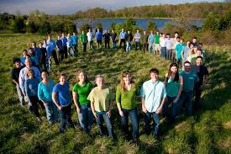
Circle of membership rules and tax implications

Slide 19
Circle of membership rules and tax implications
Basic principle is transactions which are member to member are exempt income.
Remember also the club is distinct and separate from the Trust. If incorporated the club has separate filing obligations with the Companies registrar.
If the club (not the Trust) engages in activity with anyone outside the circle of membership then it is taxable income.
There is an exemption level of net $1,000 per annum so a club can trade with non members, but its net result must be under net $1,000.
Key to be under the $1,000 level
Using the member project reimbursement system which is recommended by MD means the transfer is exempt. If the payment from the third party is made direct to the club it is caught as being outside the circle of membership rule.

Slide 20
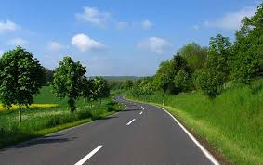
What's ahead for
Treasurer Support

Slide 21
What's ahead for
Treasurer Support
National meeting of District Treasurers is set down for August 2016 Council Meeting.
Developing a downloadable podcast via our NZ Lions site as a live Q & A session, (expect to be live around August).
Rewrite of Treasurer Guidelines should be complete by November Council Meeting.
Treasurer chat room on our NZ Lions site is under development with question and answers searchable.
Both Xero and MYOB are working on a solution to cover reporting requirements (we have national arrangements worked out with both)
Hopefully Northland Rugby might win at least one game this season!!

Slide 22
Q & A Session

Slide 23
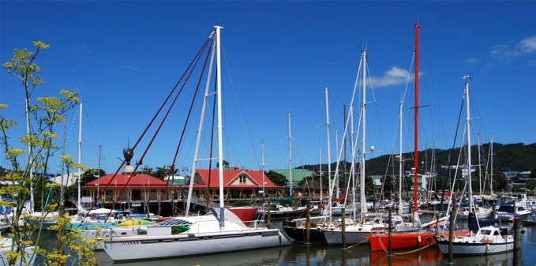
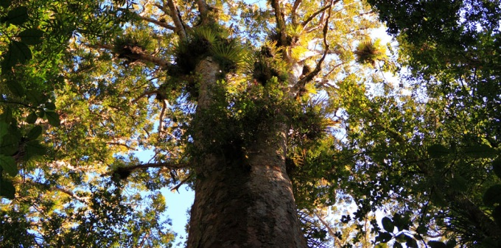
Thank you for your time

